Slide 1

Fundamentals - II

Slide 2
Recap...
Variables
abc, Abc123, abc_def, _abcd all work, but not 123abc
Data Types
Integer (int), e.g. 100, -50
Float (float), e.g. 3.141, 2e10
Boolean (bool), e.g. True, False
Etc.
Containers
String (str), e.g. “Hello World!”
List (list), e.g. [5,3.4, “This is a string”]
Tuple (tuple), e.g. (2, 9.0, “This is another string”)
Dictionary (dict), e.g. {“apple”: “red”, “banana”: “yellow”}
etc.

Slide 3
Recap...
Arithmetic Operators
+ - * / % **
Boolean Operations (we use this in ifs and loops)
Comparison Operators
Equal to (==)
Not equal to (!=)
Greater than (>), greater equal (>=)
Less than (<), less equal (<=)
Logical Operators
not
and, or
is, is not, in, not in

Slide 4
Recap...
Now where do we use these Boolean Operations
Conditional statements
if boolean operation: Do this elif boolean operation: Do that else: When every boolean operation is False

Slide 5
Recap...
Now where do we use these Boolean Operations
Loops (for loop)
In slow motion

Slide 6
Recap...
Now where do we use these Boolean Operations
Loops (while loop)

Slide 7
Recap...
Now where do we use these Boolean Operations
Loops (while loop)

Slide 8
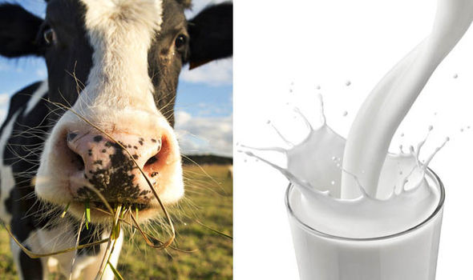
Functions
What is a function?
Job, activity or task
Something which takes input and give you output
Reusable code
Is a block (like if and loops)
Cow eat grass and gives milk
Grass is input, milk is output

Slide 9
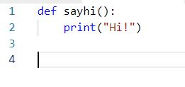
Functions
How to write a function in python?
sayhi():
Name of the function, just like variable name
(same rules apply)
def
How python knows you are writing a function
Body of the function, can have one or more lines of code

Slide 10
Functions
How to use a function in python?
A function can be called like this:
Things to keep in mind about functions
You can call a function as many times as you want
Name should follow same rules as variables
Always give meaningful names
A whole application can be written using only functions
One of the most important concept in any programming language

Slide 11


Functions
Wait, how to pass input to the function?
name
Is a variable which will save whatever is passed when you call this function
name
Variable used inside function
Calling the function and passing input
Output: Hi! bilal
Note: a function can take multiple inputs

Slide 12


Functions
How to get output from the function?
Using return statement
Calling the function and passing input
result
Whatever is in variable result will be returned wherever this function is called
Output: 7

Slide 13
Built-in VS User Defined Functions
User Defined Functions
Whatever we have done so far in today's session
sayhi(), add(firstnumber, secondnumber)
Built-in Functions
Provided by python ready to use
We have been using them from the very first day e.g print(‘hello world’), input(‘enter your name’)

Slide 14
Some useful Builtin functions
print(‘some text’) (prints text or value of variable on screen)
input(‘enter your name:’) (ask user to provide input and returns it)
len(“hello”) (calculates the length of container)
type(somevariable) (shows which type of value this variable has)
range(0,10) (gives you a range of 0 - 9 numbers, used mostly with for loop)
sum([2,4,6,8,10]) ⇒ 30 (sum of numbers)
Data type Conversion Functions
int(‘35’) ⇒ 35 (convert to integer number)
float(‘35’) ⇒ 35.0 (convert to floating point number)
bool(0) ⇒ False (converts to boolean value (i.e True or False))
list(‘hello’) ⇒ [‘h’, ’e’, ’l’, ’l’, ’o’] (converts any other container to list or you can use range to create a list of numbers)
tuple([0,1,2,3]) ⇒ (0,1,2,3)
str(35.0) ⇒ ‘35.0’ (converts anything to string representation)
For complete reference: https://docs.python.org/3/library/functions.html

Slide 15
Some useful Builtin functions
List functions: e.g l = [‘red’, ‘green’, ‘blue’, ‘orange’]
l.append(‘black’) ⇒ [‘red’, ‘green’, ‘blue’, ‘orange’, ‘black’]
l.pop() ⇒ [‘red’, ‘green’, ‘blue’, ‘orange’]
l.extend([‘white’,’magenta’]) ⇒ [‘red’, ‘green’, ‘blue’, ‘orange’, ‘white’, ‘magenta’]
l.insert(0, ‘pink’) ⇒ [‘pink’, ‘red’, ‘green’, ‘blue’, ‘orange’, ‘white’, ‘magenta’]
l.remove(‘green’) ⇒ [‘pink’, ‘red’, ‘blue’, ‘orange’, ‘white’, ‘magenta’]
l.index(‘blue’) ⇒ 2
l.sort() ⇒ ['blue', 'magenta', 'orange', 'pink', 'red', 'white']
l.reverse() ⇒ ['white', 'red', 'pink', 'orange', 'magenta', 'blue']
l.clear() ⇒ []

Slide 16



What are modules?
Collection of related functions grouped into a single module
The purpose is to make it organized and reused by others
We can also create our own module
example:
Note: we can call this module calculator

Slide 17




Import statement...
OR
To import other modules provided by python e.g math, datetime, re etc.
To import modules provided by some third party
How can i use import?
How can i use import?
How to use math functions now
How to use math functions now
For complete reference: https://docs.python.org/3/py-modindex.html

Slide 18
References
https://www.python.org/
http://jupyter.org/
https://docs.python.org/3/library/functions.html
https://docs.python.org/3/py-modindex.html

